Slide 1



CIS2350 Business Applications of AI Coursework 2022-23
John Abela
Department of CIS
Faculty of ICT
University of Malta
john.abela@um.edu.mt
+ 365 79367936
Room 1A/27
FICT Building
©John Abela 2019-2022
Faculty of
ICT
Department of
Computer Information Systems
Last Updated
11-Sep-2022

Slide 2



CIS2350 Coursework
2
Implement a multi-layer perceptron (MLP) to classify the UCI Repository Wine Quality dataset.
https://archive.ics.uci.edu/ml/datasets/Wine+Quality
The model is built as demonstrated in class.
You might have to do some preliminary pre-processing of the training data.
You must implement the project in Python using AI and ML libraries such as Keras.
Use a (random) 80/20 training/test split.
Use one-hot encoding for the class label (0 to 10).
Your MLP must have 11 input and 11 output (one hot encoded) neurons.
Start with 11 hidden layer neurons and then experiment with different values.
Express results as simple classification error.
Discuss, and interpret, the results.
What other experiments, or visualizations, can you do?

Slide 3


CIS2350 Coursework
3
Note that you do not have to implement the MLP from scratch (unless you want to).
If you implement the MLP in Keras you are marked out of a maximum of 90.
If you implement the MLP from scratch (without using Keras) then you will be marked out of a maximum of 100.
Only 10 extra marks for implementing the network from scratch?
Yes. You get 10 extra marks plus you have learned something very important.
Remember that getting 40% of the study unit marks is a lot. You have to do your own research on how to do this and also how to prepare the data.
I recommend you have a good look at the following: How to Build Multi-Layer Perceptron Neural Network Models with Keras (machinelearningmastery.com)

Slide 4
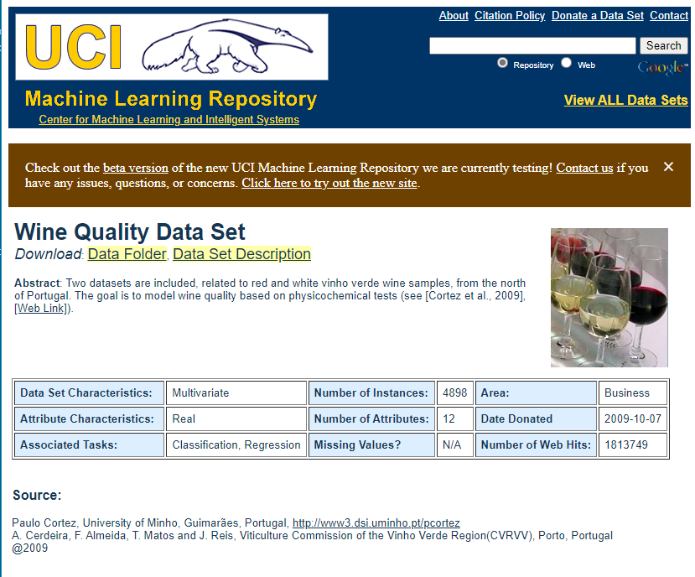
UCI Wine Quality Dataset
4

Slide 5
CIS2350 Coursework
5
Attribute Information:
Input variables (based on physicochemical tests): 1 - fixed acidity 2 - volatile acidity 3 - citric acid 4 - residual sugar 5 - chlorides 6 - free sulfur dioxide 7 - total sulfur dioxide 8 - density 9 - pH 10 - sulphates 11 - alcohol Output variable (based on sensory data): 12 - quality (score between 0 and 10) – to be one hot encoded.

Slide 6

CIS2350 Coursework
6
Relevant Paper:
P. Cortez, A. Cerdeira, F. Almeida, T. Matos and J. Reis. Modeling wine preferences by data mining from physicochemical properties. In Decision Support Systems, Elsevier, 47(4):547-553, 2009.
There are many good tutorials on the internet on how to create a simple MLP in Keras.
The coursework is worth 40% of the total marks. Expected total effort is 50 hours. This is as per the ECTS guidelines.
Do not expect convergence. Just train the network for 1000 epochs and return the training accuracy on the training and testing sets by epoch. Keras allows you to do this very easily.
No real programming is involved. Just Python scripts.

Slide 7
Submission Deadline and Notes
7
Deadline is Friday 20th January, 2023 at Midnight (23:59).
Do not forget the Plagiarism Declaration Form which must be signed.
Do not forget a Statement of Completion
You must also upload the coursework documentation, as a single Word or PDF file to Turnitin on the VLE.
You must include all the code in this PDF document.
Additionally, upload a soft copy of the document, all code, data, and binaries to the designated area on the VLE.
Drawings and images in the documentation are encouraged. Font must be Calibri 11pt.
You can quote other work as long as this is clearly indicated.
If you use images from 3rd parties simply caption with ‘reproduced from…’
Make sure you include your full name, ID or passport number, and the degree programme.
You may work in groups as long as the work you submit is your own and only your own.

Slide 8


Help & Contact Hour
8
If you get stuck ask for a contact hour.
This is strictly for problems of an academic nature.
My email is john.abela@um.edu.mt
In emergencies my mobile is 79367936. Please text before calling.
Please note that I cannot do debugging.

